Slide 1

The News & Social Media Analytics Engine
Data Structures and Algorithms -3 (25CS2103E)
Team Number: 02
Section: 12
Under the guidance of
Ms. K. Chandusha
Assistant Professor, CS&IT
Submitted by:
Thota Jhana Sri 2520090121
Sutte Alekhya 2520090126

Slide 2
Introduction
The News & Social Media Analytics Engine is a Java-based application developed to analyze large amounts of news articles and social media posts in an organized and efficient manner. With the rapid growth of digital platforms, users receive information from many sources, making it difficult to identify which topics are popular and which information is most relevant. The proposed system processes textual data and extracts useful information such as frequent keywords, hashtags, trending topics, and sentiment patterns.
The main focus of the project is the practical application of Data Structures and Algorithms to solve a real-world analytics problem. HashMap is used for efficient frequency counting, Lists for storing and managing data, Searching and Sorting algorithms for retrieving and ranking information, and Priority Queue for identifying the most trending topics. The system converts raw news and social media data into meaningful results, helping users understand current trends and opinions while demonstrating the importance of DSA in efficient data processing.

Slide 3
Literature Survey
S. No | Existing Approach | Technology / Method | Limitations
1 | News Aggregation Systems | Web APIs, Web Scraping | Mainly collect and display news
2 | Keyword Analysis Systems | Hashing, Frequency Counting | Limited trend analysis
3 | Sentiment Analysis Systems | Text Processing | Often focus only on sentiment
4 | Trending Topic Systems | Sorting, Ranking | May not combine multiple analytics
5 | Social Media Analytics | Hashtag & Keyword Analysis | Can be difficult to process large datasets
6 | Proposed System | Java + DSA | Combines keyword, hashtag, sentiment and trend analysis

Slide 4
Software Requirements
Software | Purpose
Java | Main programming language
JDK 17+ | Compile and run the project
IntelliJ IDEA / Eclipse | Development environment
Java Collections Framework | Implement data structures and algorithms
CSV / TXT Files | Store and read news and social media data
Git / GitHub | Version control and code management

Slide 5
Hardware Requirements
Component | Requirement
Processor | Intel Core i3 or above – runs the application
RAM | 4 GB minimum – supports program execution
Storage | 10 GB free space – stores project files and data
Monitor | 14" or above – displays the application
Keyboard & Mouse | Standard – user interaction

Slide 6
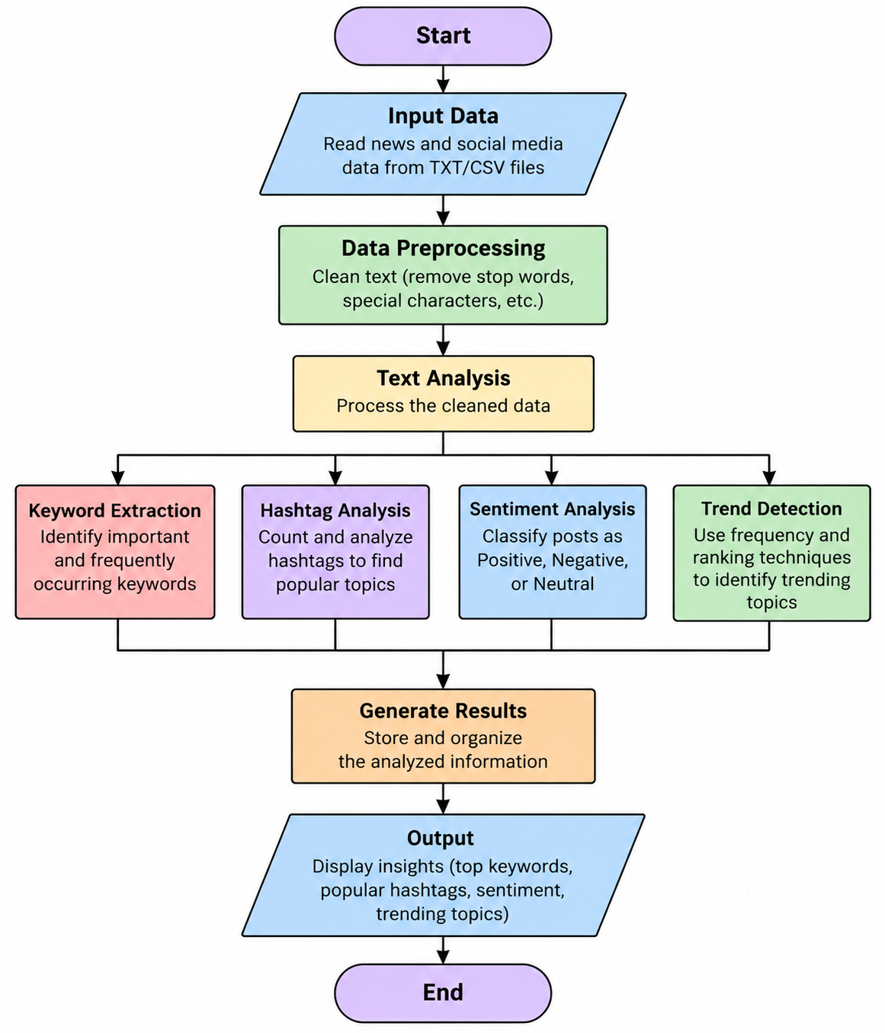
Methodology

Slide 7
Conclusion
The News & Social Media Analytics Engine successfully demonstrates how Data Structures and Algorithms can be applied to analyze and organize continuously growing textual data. By processing news and social media content, the system can identify popular keywords, hashtags, trending topics, and sentiment, providing a clear overview of the information present in the dataset.The use of HashMap, Lists, Searching, Sorting, and Priority Queue makes the system efficient for storing, retrieving, counting, and ranking data. Overall, this project provides a practical and easy-to-understand application of DSA concepts while showing how efficient algorithms can transform raw data into useful and meaningful insights.

